Slide 1
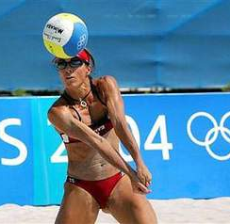
Beach volleyball
Kinga Szpil

Slide 2
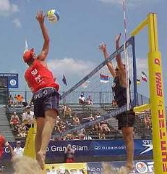
Beach Volleyball
Sports team game. Variation of volleyball - is played in the sand. It has been an Olympic discipline since 1996.

Slide 3
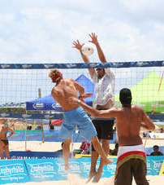
Game rules:
The game continues until two sets are won: the first two to 21 points, a possible third to 15.
You can bounce with any part of the body, the team has three taps to hit the ball to the other side of the field.
It is not a violation for opposing players to hold the ball over the net, but touching the net is.
The time to perform the play is 5 seconds, and it can only be done with your hand.
After seven points in the set, the teams switch between the halves of the field

