Slide 1
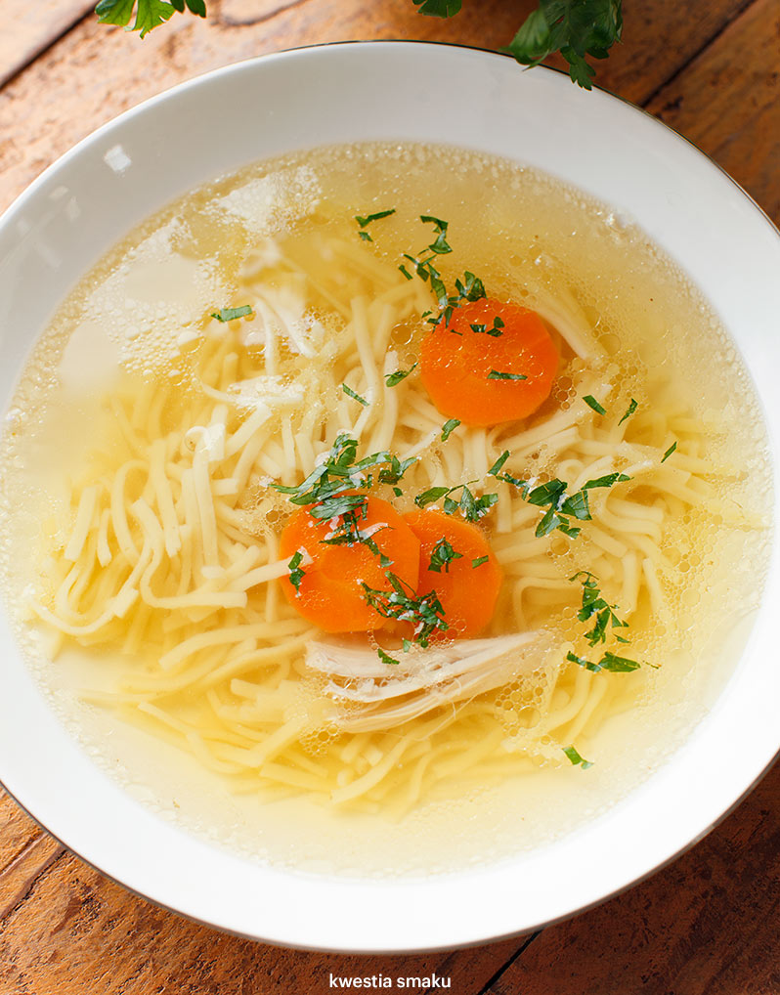
Recipe for chicken soup

Slide 2
Ingredients: 6 servings
Ingredients 6 servings - 1 chicken weighing approx. 2 kg or (2 large thighs and 1 chicken body with neck and wings - approx. 2 kg of meat) - 300 g of beef, e.g. entrecote, brisket, beef eye - offal: 10 chicken hearts and 5 stomachs or 1 turkey neck - 3 liters of water - 1 vegetables: 2 carrots, 1 parsley, 1 onion, 2 sprigs of parsley, a piece of celery, leek, optionally a cabbage leaf - spices: 1 tablespoon of sea salt, 3 grains of allspice, 1 bay leaf, 4 whole peppercorns

Slide 3
Preparation:
If we have a whole chicken, cut it into parts - cut off the neck, wings, thighs. Leave the body with the breasts. Rinse all parts of the chicken, beef and offal, then place in a large pot and pour cold water. Season with salt and bring to a boil over medium heat. After boiling, reduce the heat and hum in the brew. Reduce heat and cook over low heat (the broth is only supposed to "flash") under the slightly open lid for about 1 1/2 hours. In the meantime, prepare the vegetables: peel the carrots, parsley and celery (or for greater flavor - just wash it thoroughly). Rinse the onion, leek and parsley (do not peel the onion, its husks will give the soup a nice color). Place the vegetables in the broth and boil them. Add spices: allspice, bay leaf and black pepper. Reduce heat and simmer for about 1 hour or up to 1 1/2 hours. Serve the broth hot, with cooked noodles, chopped parsley, thinly sliced ​​carrots from the broth and pieces of chicken meat.

Slide 4
Tips:
A delicious broth can only be cooked with chicken without beef and giblets. Just add a little less water. The remaining broth should be strained, boiled and closed in jars. Put it in the fridge after it has cooled down. Store meat and vegetables from the broth. The next day, you can prepare tomato soup from the rest of the broth. Cooked broth meat can be used for: stuffing for croquettes, dumplings with meat, patties.

Slide 5
ENJOY YOUR MEAL!!!!!!

