Slide 1
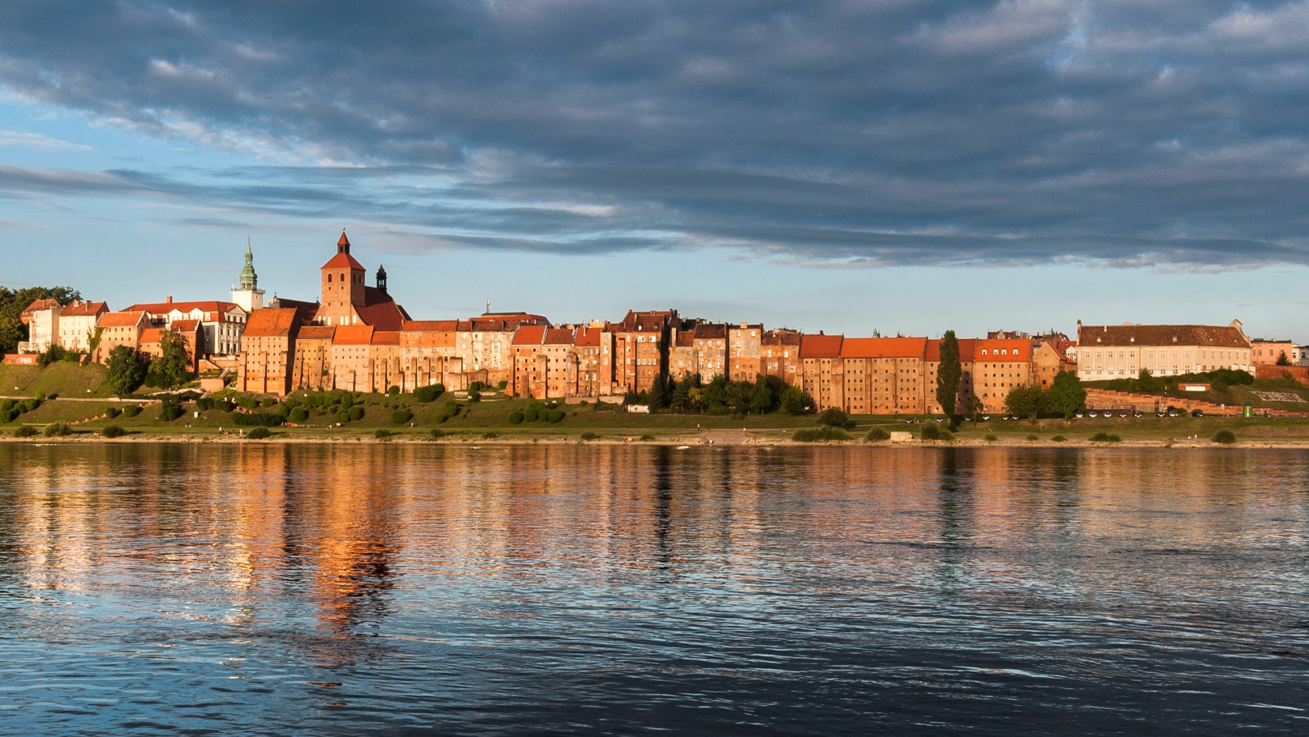
I was born in Grudziądz.
Grudziądz is a city located in the northern part of Poland on the left coast of the river Vistula. Grudziądz is a city with population of 100 000 of people. My city is still developing. We have got a lot of interesting places to visit. On the left coast of the river Vistula there are the amazing, old granaries.

Slide 2
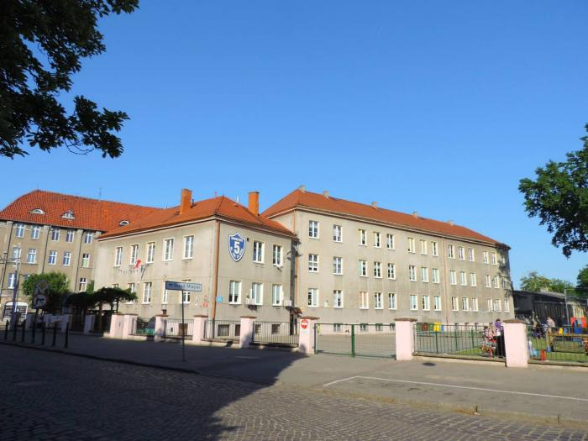
My school
I am a student at the Elementary School no. 5
im. płk. Stanisława Sitka

Slide 3
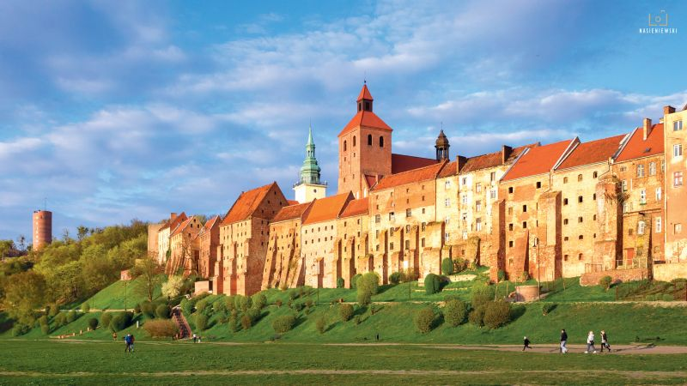
My favourite place
My favourite place is the coast nearby the river Vistula. It has got a beautiful landscape with the excellent view on the river.
I often go there for a walk with my parents or with my friends.

Slide 4
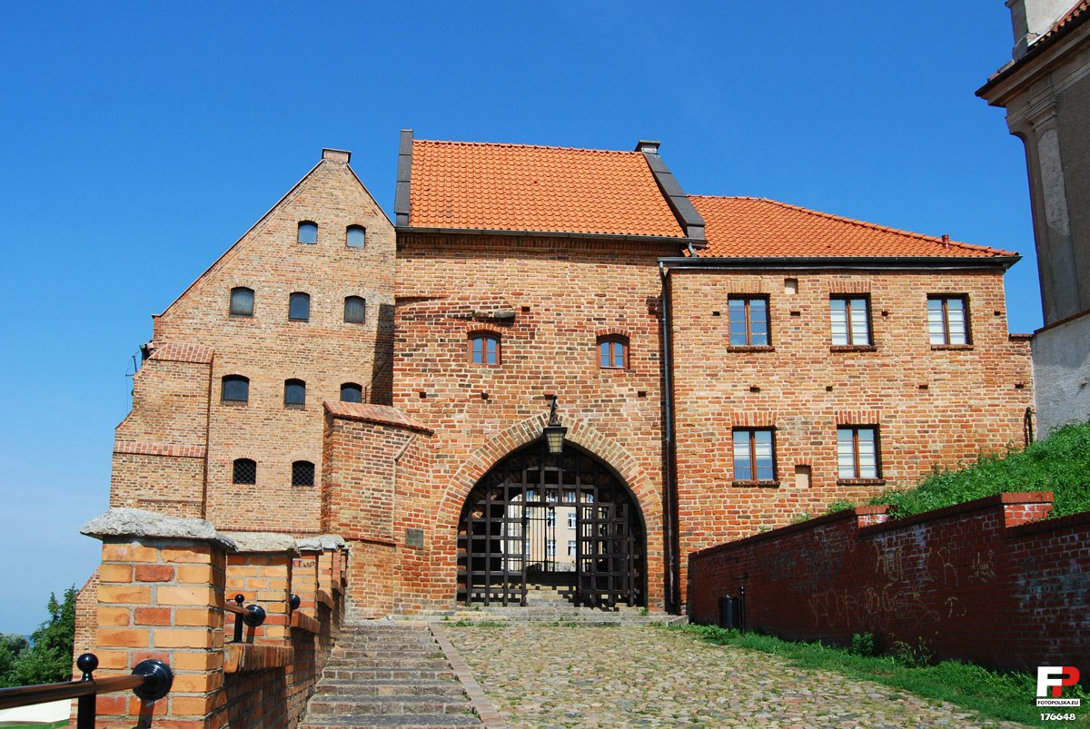
The very impressive monument is the old Water Gate from the XIVth century.

Slide 5
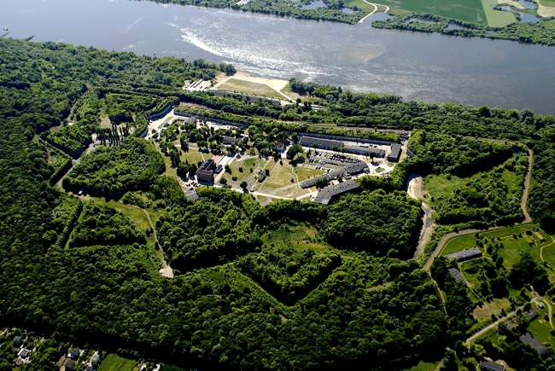
Fortress “Rawelin”
It is the fortress raised in the 18th century by the king Frideric 2nd the Great.
It was used for defending the town.

Slide 6
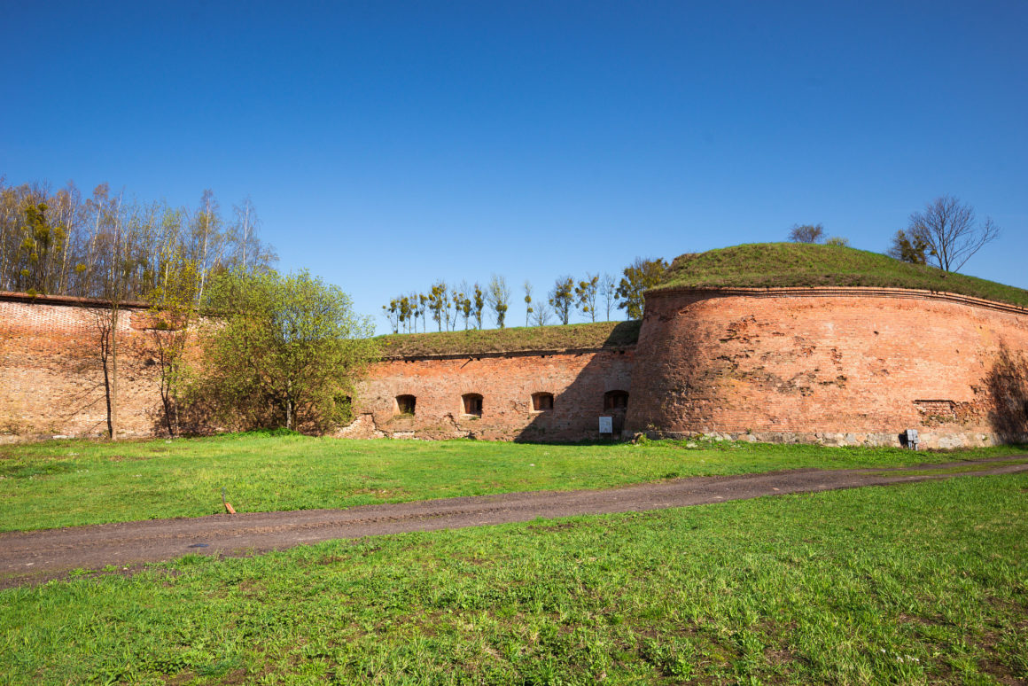
Part of the forts.
The most of area is not available for visitors.

Slide 7
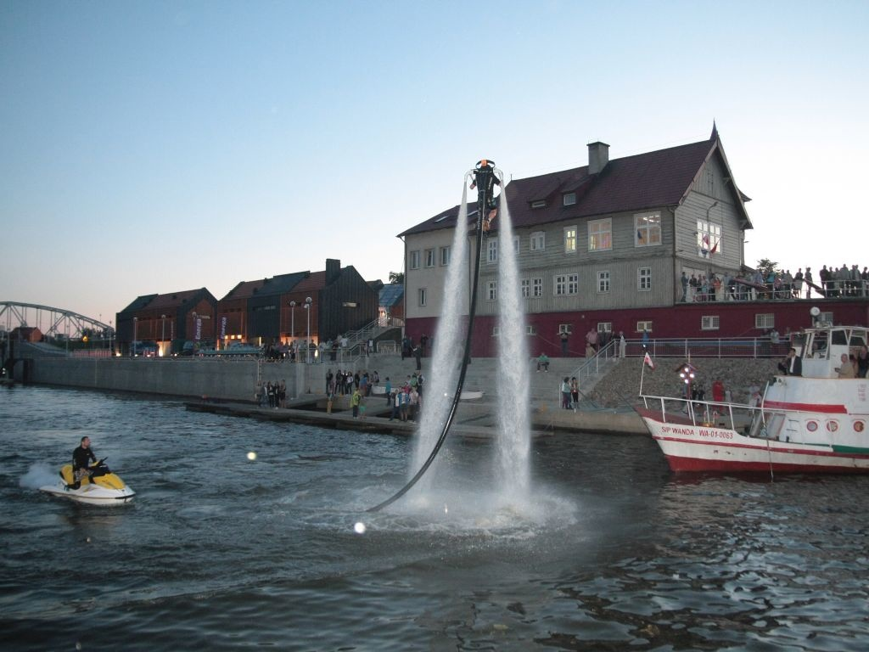
On the coast of the river Vistula we have got a very nice view from Marina – renovated historical harbor.

Slide 8
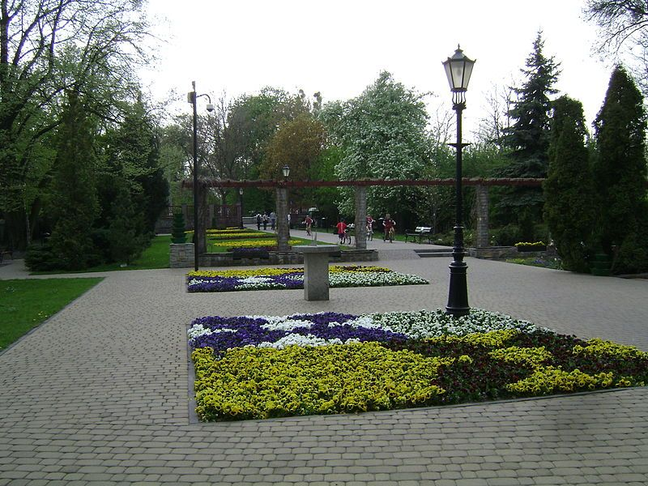
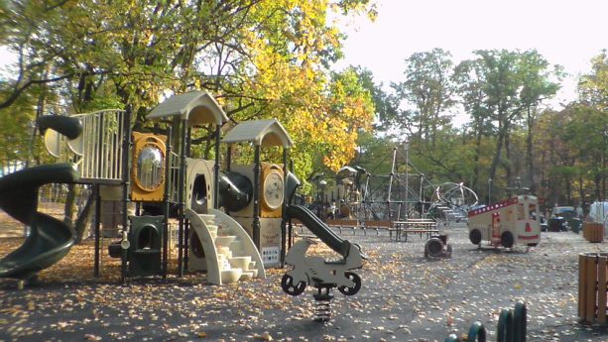
For the older citizens and children we have got many parks and playgrounds.

Slide 9
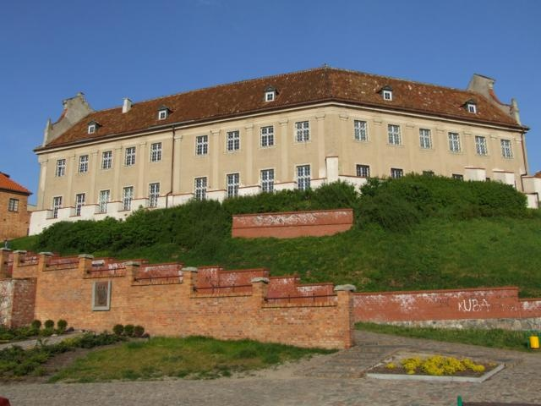
The Benedictine monastery was built in the middle of the 18th century, in Baroque style. Currently, there is the Museum of exhibits related to the history of the city.

Slide 10
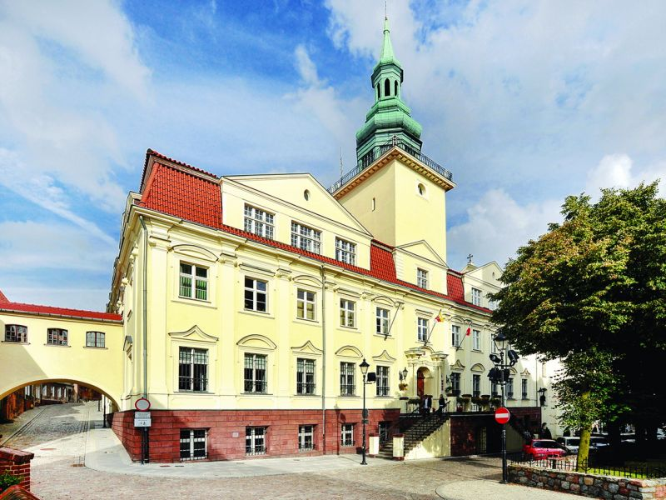
Former Jesuit College built in the 17th-18th centuries in Baroque style, now the seat of the local government.

Slide 11
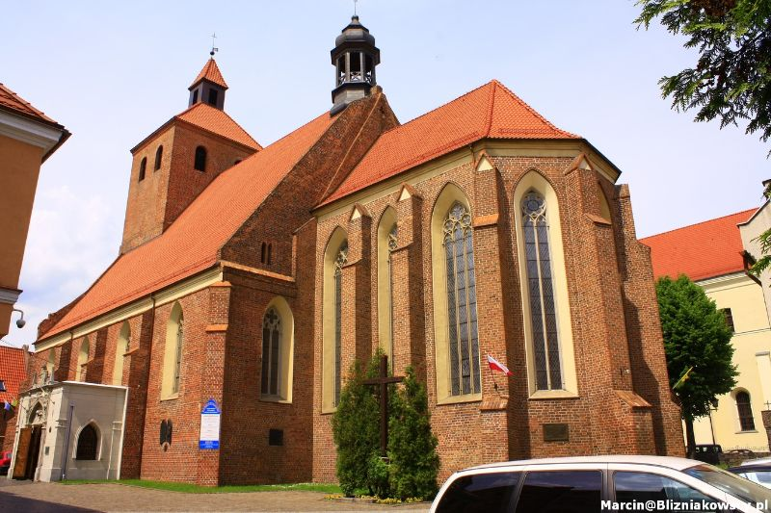
Church Nicholas, now Fara, originally stood a wooden church, and the construction of the present church began in 1286 and lasted many years.

Slide 12
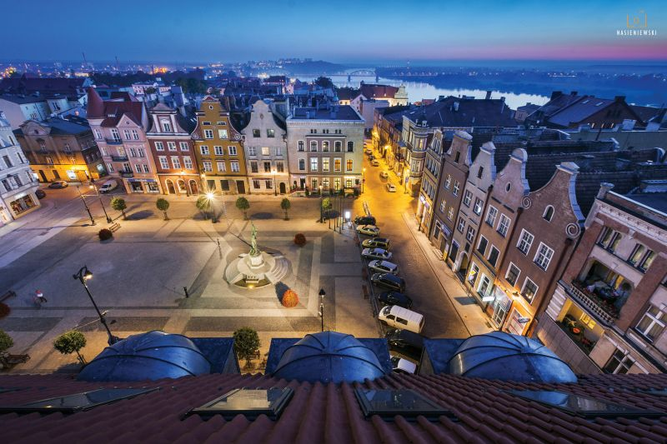
The old town by night.

Slide 13
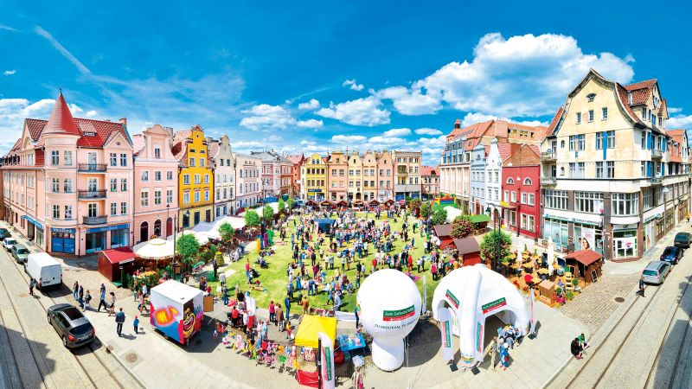
The old town as a place of events and meetings.

Slide 14
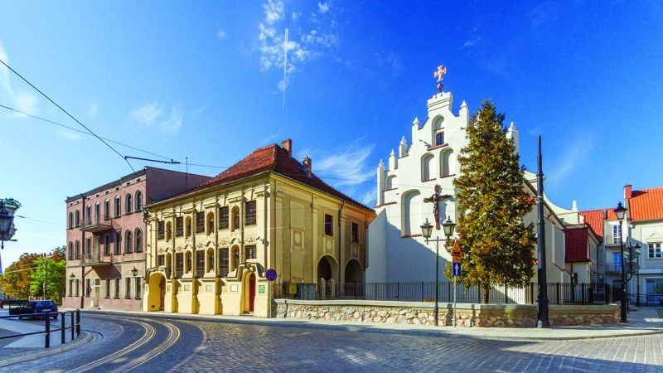
Monastery was built in 1730, in baroque style. The facade of the palace is adorned with shell niches, where there are sculptures of eight holy monks and Benedictine nuns.

Slide 15
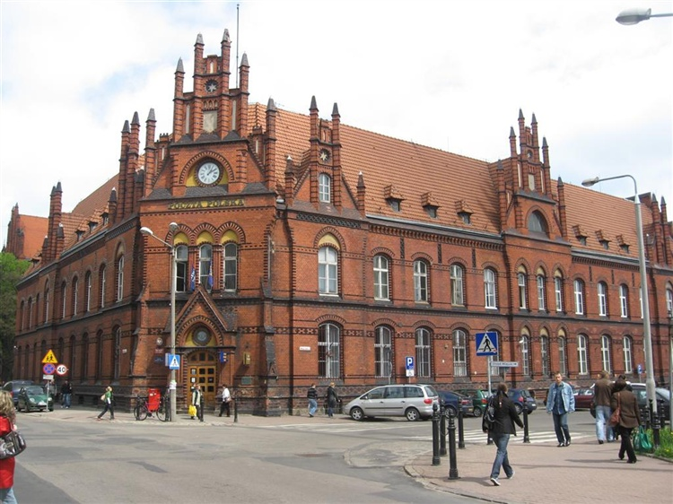
The monumental building was raised at the end of 19th century. Nowadays, it is a seat of the main post.
It was built in the gothic style.

Slide 16
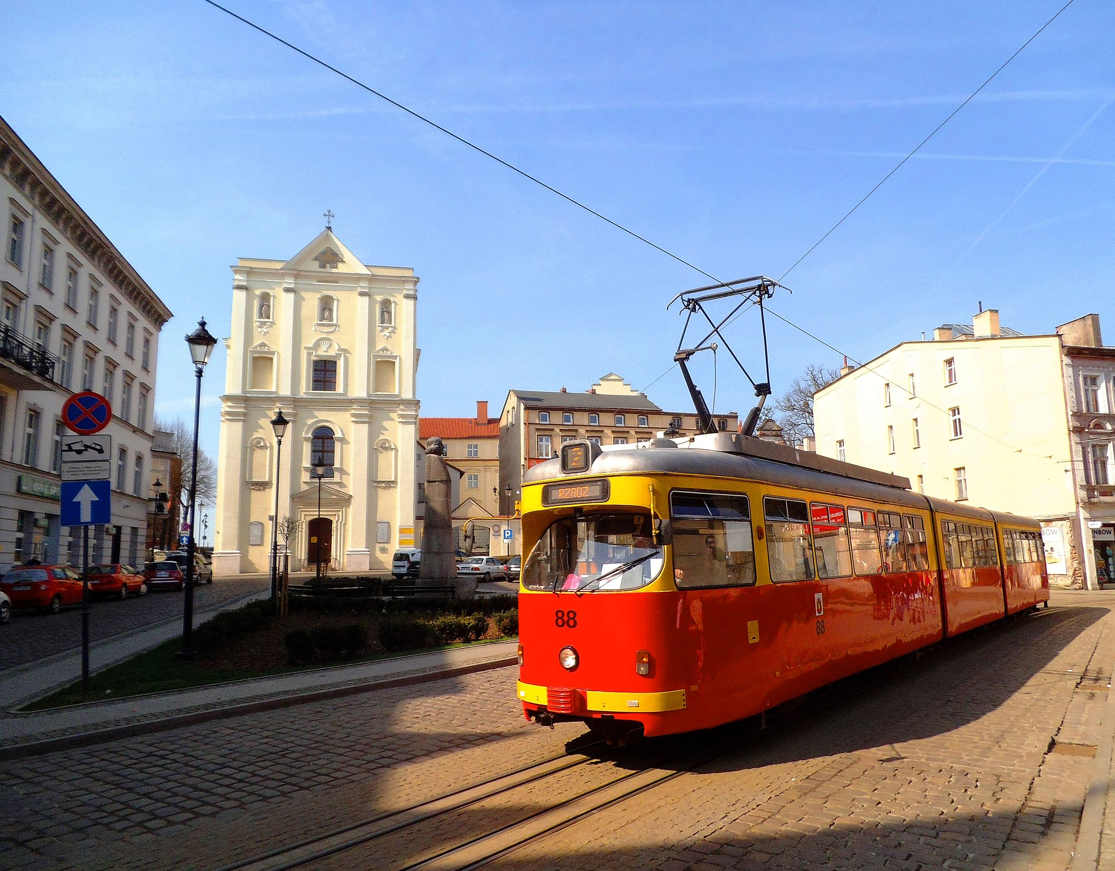
Trams were started in 1896, initially as equine and then electric.
Grudziądz is the smallest city in Poland with trams.
This is a very good and fast mean of communication.

Slide 17
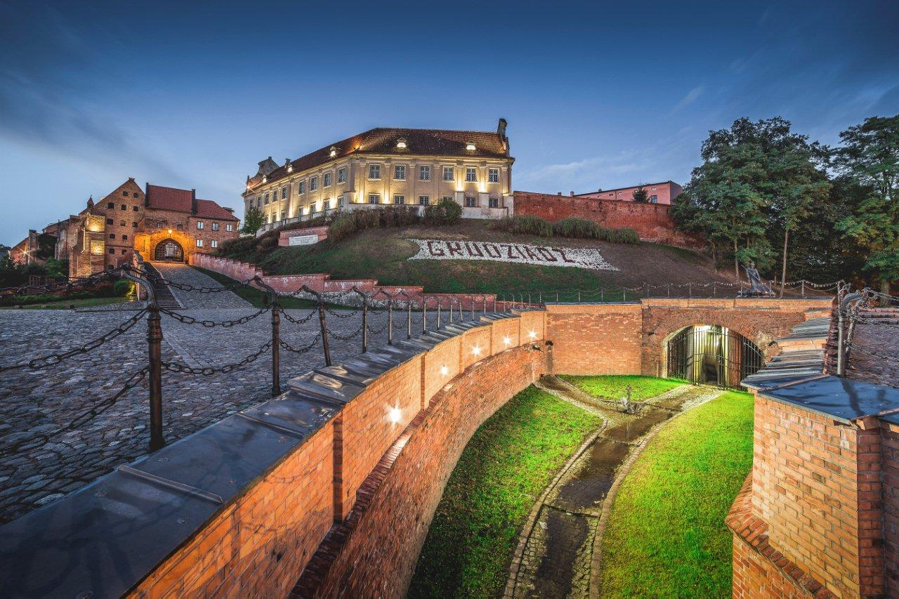
In my opinion, Grudziądz is a really beautiful place to visit.

Slide 18
Thank you for attention,
Victoria Kubala

